Slide 1

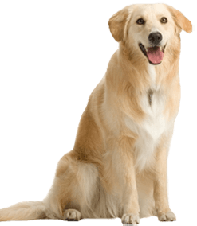
Generative dog images
Max de Goede

Slide 2
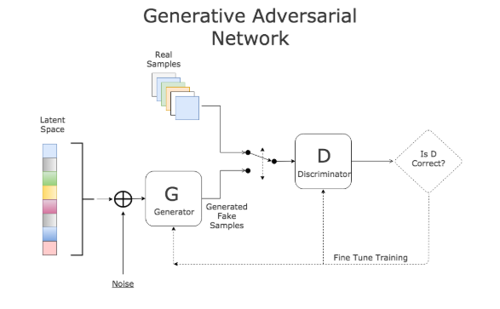
GOAL – Learning about GAN (Generative Adversarial Network)
Consists of:
Generator
Discriminator

Slide 3
Gan in this project
Stanford dog dataset
- Images/Annotation (Dog Location with xyMax and xyMin)
- 120 Categories (Breed)
- 20.580 Total images
Generator
CNN
Discriminator
CNN Network, can be seen as a way to create object detection

Slide 4
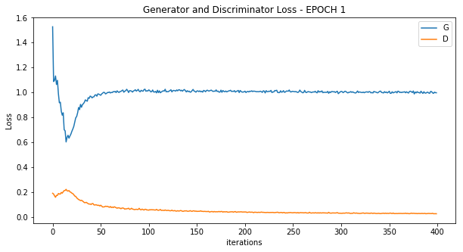
Result

Slide 5
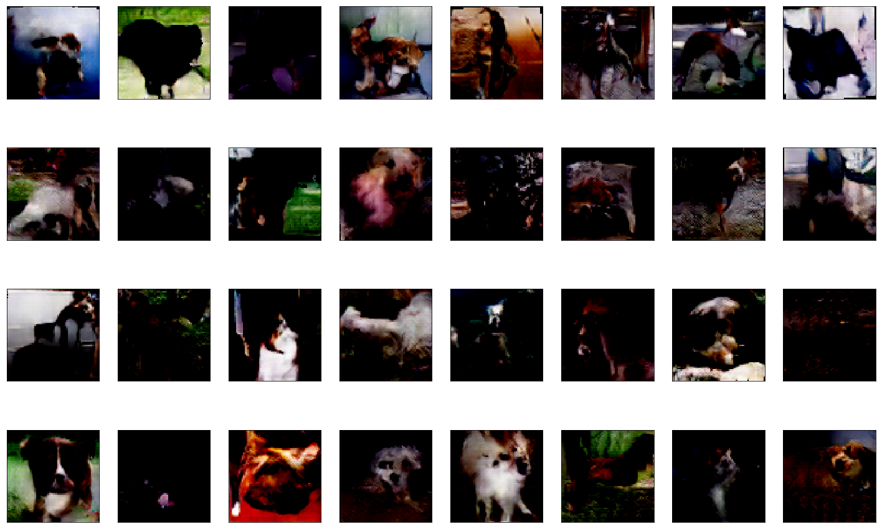
Generated images

Slide 6
Cool examples of GANS
Fake video recognition
Super Resolution
Creates higher resolution images.
Face Frontal View Generation
Translating side images or people to front view.

